Slide 1

HR ANALYSIS
k. Mohan Chand
e. Rohini Kumar

Slide 2
Task Insights
Task 1
Create 3 KPI’s that list the number of employees, percent of workers working remotely and in HQ and the average age.
Task 2
Create a Line Chart showing the
hiring rate By Year.
Task 3
Create a Donut Chart representing the gender of the employees.
Task 4
Create a 3 Bar Charts showing Employee by State, By Department and By Race.

Slide 3
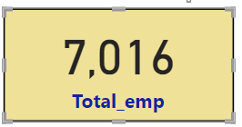
> Key Performance Indicator (KPI)
A Key Performance Indicator (KPI) is a measurable value that demonstrates how effectively an organization is achieving its key business objectives. Organizations use KPIs at multiple levels to evaluate their success at reaching targets.
KPI - I : Number of Employees
DAX Measure : Total_emp = COUNT(HR[id])
Fig 1 : Number of Employees

Slide 4
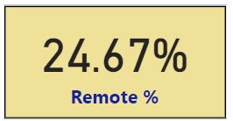
> Key Performance Indicator (KPI)
KPI - II : Percent of workers working in Remote.
In here, I create a new column and used IF condition statement and made the rows with HQ in location column as 0’s and the row with Remote as 1’s. Soon after that a new column with Remote_Status is created as per the conditions.
DAX Measure : Remote_Status = IF(HR[location] = "Remote" , 1,0)
Now sum all the 1’s in Remote_Status column using DAX measure in the name Remote_Count .
DAX Measure : Remote_Count = SUM(HR[Remote_Status])
Now to get the Remote % , divide the Remote count with Total number of employees .
DAX Measure : Remote % = DIVIDE([Remote_Count],[Total_emp])
Fig 2 : Remote %

Slide 5
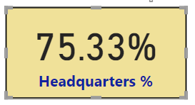
> Key Performance Indicator (KPI)
KPI - II : Percent of workers working in Headquarters .
In here, I used the COUNTROWS function to count only the rows with Head quarters in the location column.
DAX Measure : Hq_Count = COUNTROWS(FILTER(HR,HR[location] = "Headquarters"))
Now to get the Headquarters % , divide the Hq_Count with Total number of employees .
DAX Measure : Headquarters % = DIVIDE([Hq_Count],[Total_emp])
Fig 3 : Headquarters %

Slide 6
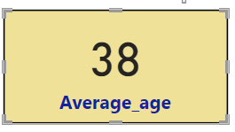
> Key Performance Indicator (KPI)
KPI - III : Average Age .
In finding the average age , I used the Dax Measure that average the age column in the HR table.
DAX Measure : Average_age = AVERAGE(HR[Age])
Fig 4 : Average Age

Slide 7
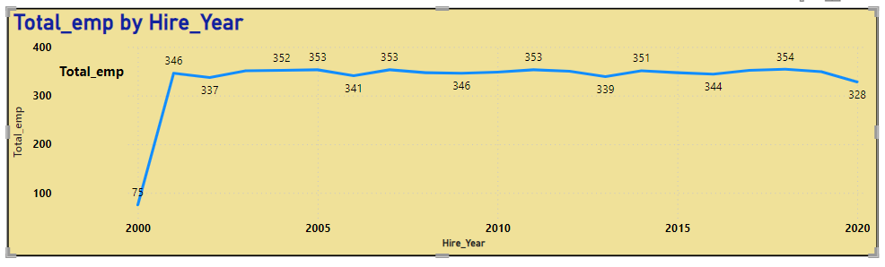
> Line Chart ..
Task - 2 : Line Chart showing the Hiring rate per year.
First, I will extract the year from the hire_date column and name that column as Hire_Year.
DAX Measure : Hire_Year = YEAR(HR[hire_date])
By keeping Hire_Year in X axis and Total_Emp in Y axis, a line chart is created displaying Hiring Rate per Year.
Fig 5 : Hiring Rate per Year

Slide 8
> Donut Chart ..
Task - 3 : Don’t Chart Representing the gender of Employees
To create this chart, I used the COUNTROWS function to count the Male, Females and Non-Conforming gender. This can also be done by keeping the gender column in legend and Count of id in Values.
For Male ,
DAX Measure : Male_Count = COUNTROWS(FILTER(HR,HR[gender] = "Male"))
For Female ,
DAX Measure : Female_Count = COUNTROWS(FILTER(HR,HR[gender] = “Female"))
For Non-Conforming ,
DAX Measure : Non-Conforming_Count = COUNTROWS(FILTER(HR,HR[gender] = “Non-Conforming"))

Slide 9
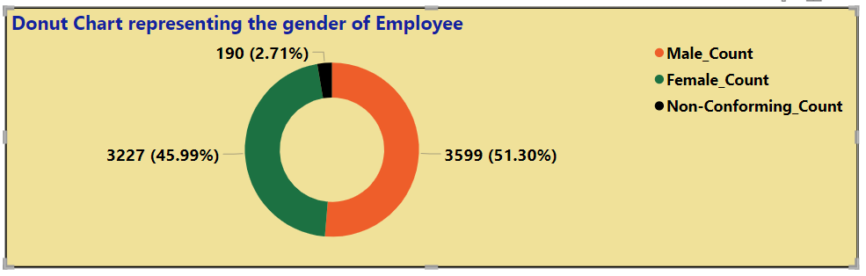
> Donut Chart ..
Fig 6 :Donut Chart Representing the gender of Employees

Slide 10
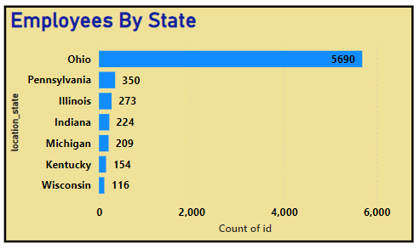
> Bar Chart ..
Task - 4 : Bar charts showing Employees By State, By Dept, and By Race
1 ) Bar Chart Showing Employee By State
The Bar Chart, Employee By State shows that the state Ohio has highest count of employment 5690 , where as the state Wisconsin has the lowest count of employment 116 .
It can also state that the state Ohio might be the key hub for the company’s operations.
Also, the state Wisconsin potentially indicating regions where the company has less presence, or where the expansion opportunities might exist.
Fig 7 : Bar chart showing Employee By State.

Slide 11
> Bar Chart ..
Task - 4 : Bar charts showing Employees By State, By Dept, and By Race
2 ) Bar Chart Showing Employee By Department
The Bar Chart, Employee By Department shows that the Engineering dept has occupied the more employees in the company with 2070 employees.
This indicates the company’s resources and focus may be concentrated. This department may require more resources, office space and management attention.
In speaking about growth, Auditing with only 23 employees is the smaller department compared to all and this indicated the more hiring might require.
This charts help in staff balance, if the company has a balanced distribution of employees across departments.

Slide 12
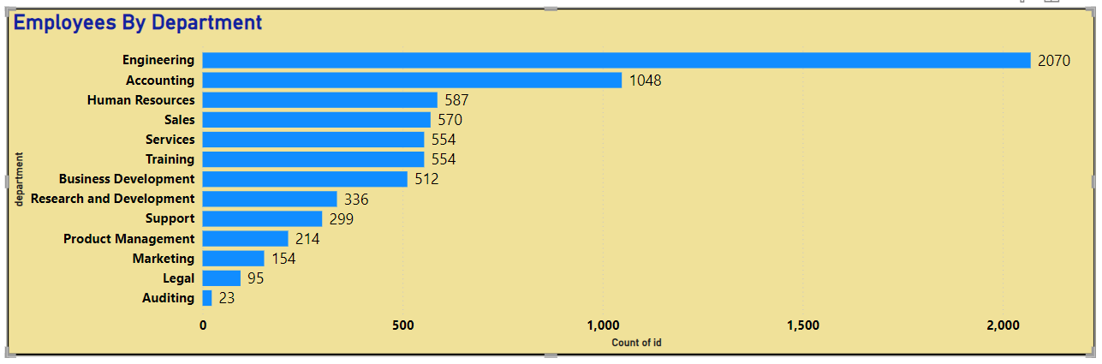
> Bar Chart ..
Fig 8 : Bar chart showing Employee By Department.

Slide 13
> Bar Chart ..
Task - 4 : Bar charts showing Employees By State, By Dept, and By Race
2 ) Bar Chart Showing Employee By Race
The Bar Chart, Employee By Race shows that the White racial group with 1990 is the most and Native Hawaiian or Other Pacific Islander with 356 is the least represented racial group in the company.
It indicates the company for Equity Efforts by highlighting the areas where the diversity and inclusion effort might need to strengthen.
If certain racial group is underrepresented, it might suggest a need for more targeted recruitment or support.
It also makes to understand the cultural strengths and gaps within the organization, which can be important for better fostering the company’s work place and environment over time.

Slide 14
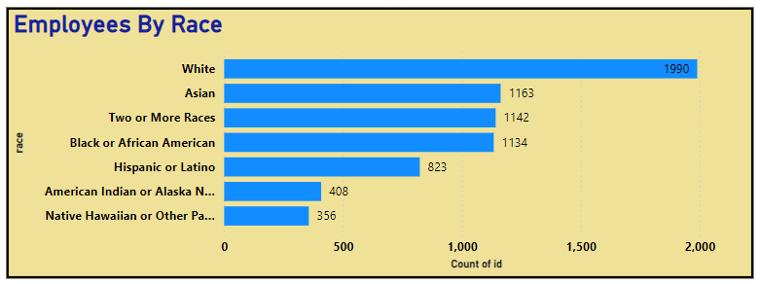
> Bar Chart ..
Fig 9 : Bar chart showing Employee By Race.

Slide 15
> Multiple Insights ..
Employees By Age Group
The Bar Chart, Employees By Age Group shows the proportions of different age groups within the workforce. In the charts, the age group 20-30 with 2001 and age group 51-60 with 1220 has the most and least employees.
By this charts, it helps to understand the demographic makeup of the company. Also make the generation comparison across the different generations. It is also helpful in identify trends in hiring practise. For instance, a high concentration of younger employees might indicates recent hiring efforts targeting fresh graduates.
Can also determine the age group that are about to retire. This helpful in knowledge transfer.
It can also drag to the conclusion that training and development needs of different age groups. Younger generations might need career opportunities , while older one’s might benefit form mentoring programs.

Slide 16
> Multiple Insights ..
Racial Diversity.
There are 7 racial groups in the HR table. The percent of each group is displayed in the following way.
This calculation involves the count of total rows of respective group and then divide it with total number of employees . This gets the racial group %.
Displaying the process for one group.
For White racial group,
DAX Measure : White_Count = CALCULATE(COUNTROWS(HR),HR[race] = "White")
DAX Measure : White % = DIVIDE([White_Count],[Total_emp])

Slide 17
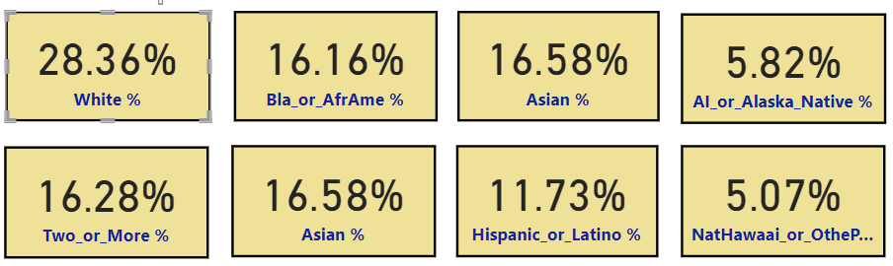
> Multiple Insights ..
Racial Diversity.
Fig 10 : Racial Diversity.

Slide 18
> Multiple Insights ..
Departmental Diversity.
A Stacked area chart is used here to visualize the diversity across different departments. This identify which group is more balanced and which group might need attention.
It helps to focus on departments with less diversity and create initiatives to improve inclusivity. Identify the successful diversity practice and replicate them across the organization.
In the chart, the lower percentage of Native Hawaiian or Other Pacific Islander employees indicates an underrepresented whereas the higher percentage of White employees suggest that this group is overrepresented among other.
It shows that some recruitment strategies has to implement that aim to attract Native candidates and also develop some Employee Resource Group to provide support and networking opportunities.
Celebrate cultural events and milestones related to Native Hawaiian heritage to promote awareness and appreciation within the organization.

Slide 19
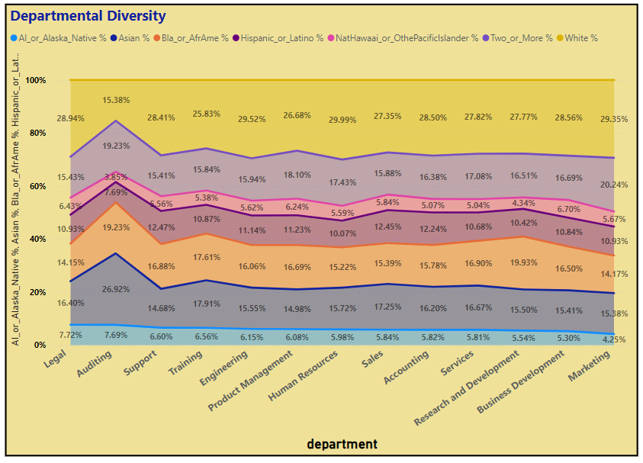
> Multiple Insights ..
Fig 11 : Departmental Diversity.

Slide 20
> Multiple Insights ..
Geographical Diversity.
A Stacked area chart is used here to visualize the diversity across different states. This identify which group is more balanced and which group might need attention.
From this insights, its easy to identify regions with higher and lower representation of specific racial group. In here the employee count (1624) and shaded region (28.54%) is higher for Whites in Ohio. Whereas States like Michigan (13), Kentucky (9) and Wisconsin (4) have the lower employee count for Native Hawaiian or Other Pacific Islander.
Also the racial group American Indian or Alaska Native is also a underrepresented group it also has the lower employee count and recruitment strategies has to be planned.
Use this data to focus recruitment effort on underrepresented regions. Can also design diversity and inclusion programs that are specific to the needs of different regions.

Slide 21
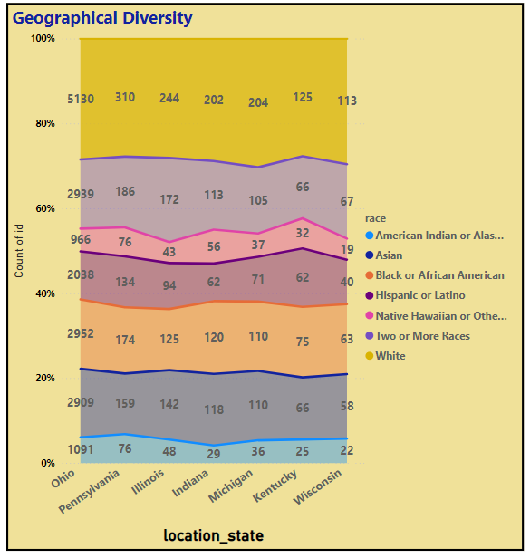
> Multiple Insights ..
Fig 12 : Geographical Diversity.

Slide 22
> Multiple Insights ..
Gender Diversity.
A Stacked area chart is used here to visualize the diversity over gender. This identify which gender is more balanced and which gender might need attention.
From this insights, it is clear that Males (1000) and Females (933) shows the highest employee from Whites. Whereas the Males (191) and Females (159) shows the lowest employee count from Native Hawaiian or Other Pacific Islander.
From this it shows that the workplace and inclusion with higher gender and racial diversity tends to more innovative and perform better financially. Diverse teams brings a variety of perspectives, which can lead to more creative solutions and better decision making.
Efforts to improve diversity and inclusion often focus on creating allies among those in positions of power. Men can support gender diversity, and people from majority racial groups can support racial diversity, helping to create a more inclusive environment for all.

Slide 23
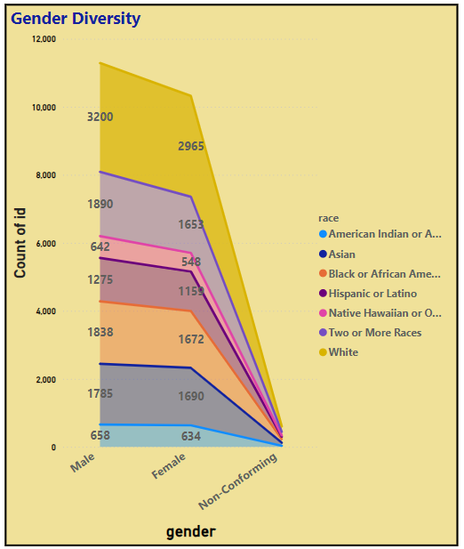
> Multiple Insights ..
Fig 13 : Gender Diversity.

Slide 24
> Multiple Insights ..
Tenure Analysis.
It is the process of evaluating the length of time employees have been with an organization. This analysis can provide valuable insights into employee retention, job satisfaction, departmental stability, and overall workforce dynamics.
The important key metric in Tenure Analysis is Average Tenure, it is the average length of time employees have been with the organization. It helps in understanding the general rate and identifying any pattern of long-term or short-term employment.
In here the average Tenure is about 14.
For tenure calculation in years,
DAX Measure : Tenure Years = DATEDIFF(HR[hire_date], IF(ISBLANK(HR[term_date]) ,
TODAY() , HR[term_date]) , YEAR)

Slide 25
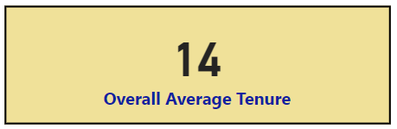
> Multiple Insights ..
Average Tenure Analysis.
To calculate the Average Tenure , divide the sum of tenure with total employees.
DAX Measure : Overall Average Tenure = DIVIDE(SUM(HR[Tenure Years]),[Total_emp])
Fig 14 : Average Tenure.

Slide 26
> Multiple Insights ..
Tenure By Department.
The insights indicate the department Auditing (14.4) having high average tenure likely have good retention strategies and understanding these can help to improve the other departments.
The department named Legal with short tenured employees (13.2) might highlight areas where more training and development are needed to reduce the turnover.
This insight also gives the employment satisfaction towards the department. Obviously the Auditing dept has long tenure.
Also the department with higher tenure indicates the strong leadership impacts. To develop the active coordination among all and to the welfare of the company those leadership impacts are supposed to share and pass the signal to practise in active manner.

Slide 27
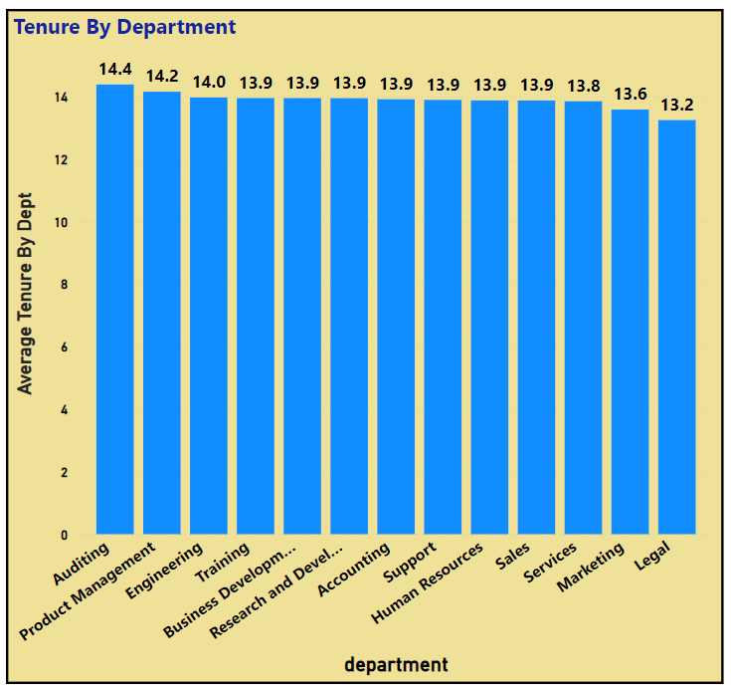
> Multiple Insights ..
Tenure By Department.
For calculating the Average Tenure over Department ,
DAX Measure : Count of Emp by Dept = CALCULATE(COUNT(HR[id]),
ALLEXCEPT(HR,HR[department]))
DAX Measure : Total Tenure by Dept = CALCULATE(SUM(HR[Tenure
Years]), ALLEXCEPT(HR,HR[department]))
DAX Measure : Average Tenure By Dept = DIVIDE([Total Tenure by Dept], [Count of Emp by Dept],0)
Fig 15 : Tenure By Department.

Slide 28
> Multiple Insights ..
Tenure By Location.
The insights indicate that the Headquarters has tenure average of 13.89 and Remote has 13.98.
The similarity in average tenure suggests that employees, regardless of their work location, experience comparable levels of job satisfaction and engagement. This indicates that the company's culture and policies are effectively supporting employees in both settings.
The slightly higher average tenure for remote workers might indicate that your remote work policies are successful and possibly even more conducive to long-term employee retention than on-site work.
This can be a strong selling point for your company's remote work strategy.
The higher tenure for remote employees may suggest that remote work offers a better work-life balance for employees, allowing them to stay longer with the company.

Slide 29
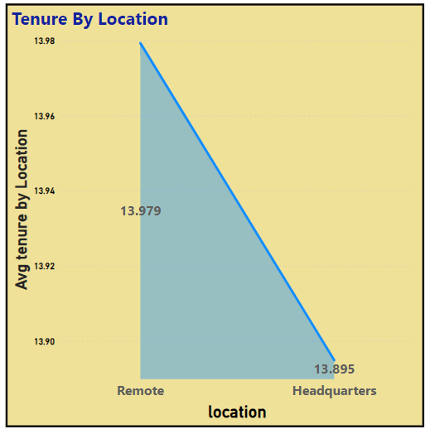
> Multiple Insights ..
Tenure By Location.
For calculating the Average Tenure over Location ,
DAX Measure : Count of Emp by Location = CALCULATE(COUNT(HR
[id]),ALLEXCEPT(HR,HR[location]))
DAX Measure : Total Tenure by Location = CALCULATE(SUM(
HR[Tenure Years]), ALLEXCEPT(HR,HR[location]))
DAX Measure : Average Tenure By Location = DIVIDE([Total
Tenure by Dept], [Count of Emp by Dept],0)
Fig 16 : Tenure By Location.

Slide 30
> Multiple Insights ..
Tenure By Job title and Gender.
The insights indicate that the Job title named Assistant Professor has total male dominance over other gender about 18 average tenure. This shows that that the Individuals in such positions often have longer tenures due to their strategic roles and significant investment in the company.
The same properties can be visible in Office Assistant IV as well. In Statistician II, there is a equal composition for both the male and female genders which is about 17.67 average tenure.
From this insights it enables to understand how long the employees stay in the specific roles before getting promoted can help identify career growth pathways within an organization.
Also the pattern pf employees transitioning from one job title to another can provide insights into skill development and career trajectories.

Slide 31
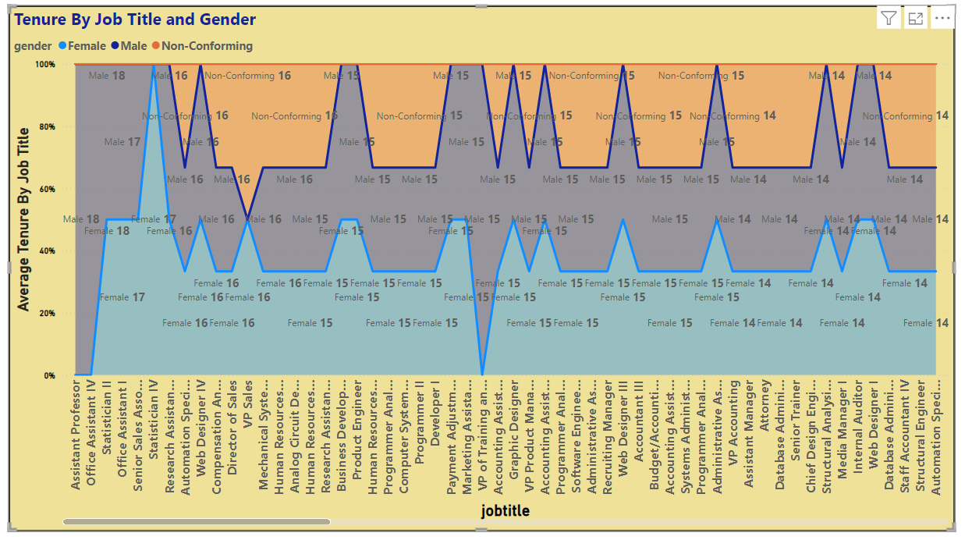
> Multiple Insights ..
Fig 17 : Tenure by Job title and Gender.

Slide 32
> Multiple Insights ..
Monthly & Quarterly Hiring Insights.
The insights determine the employee hiring is most in the month of October (1991) and least in the month of February (1645).
It gives the understanding when the organization tends to ramp up the hiring and may highlight busy recruitment periods.
There is a scope of detection for seasonal hiring patterns. For instance, some industries hire more in certain seasons due to business cycles or peak periods.
The quarterly hiring makes to identify the growth by looking at increase in hiring across quarters. The Qtr 4 (Oct – Dec) has the highest hiring compared to all other. This might indicates expansion or increased project demands.
This shows that the from Qtr 1 to Qtr 2 there is a small growth of hiring in about (5520) and from Qtr 2 to Qtr 3 there is again a decrease in growth to (5478) and then in Qtr 4 there is a rapid employee growth about (5766) .

Slide 33
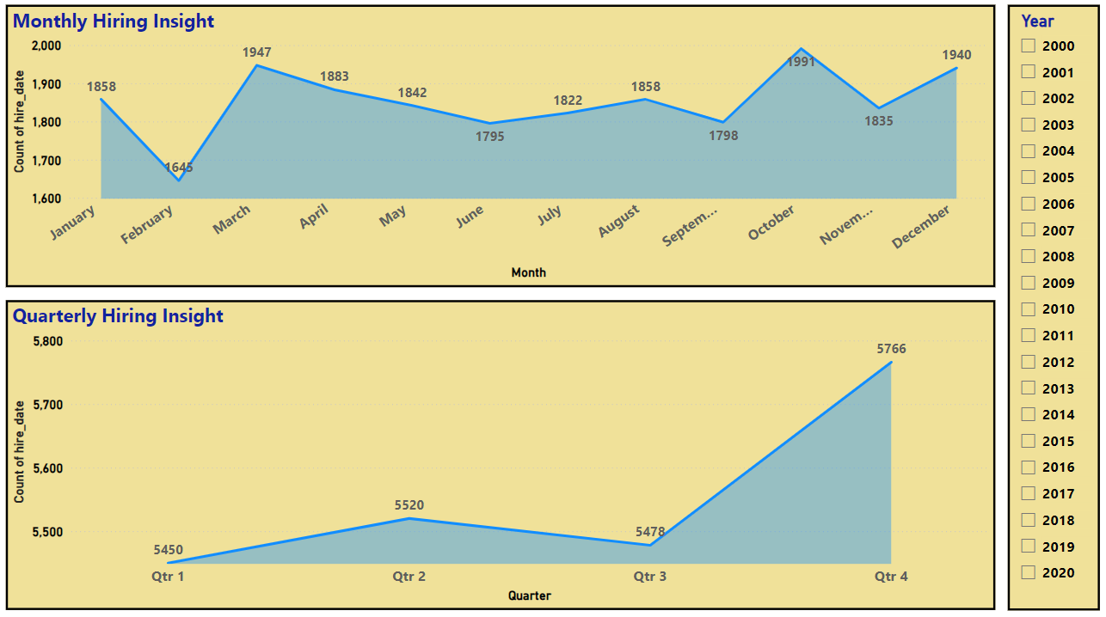
> Multiple Insights ..
Fig 18 :Monthly and Quarterly Hiring Insights.

Slide 34
> Multiple Insights ..
Monthly & Quarterly Hiring By Race.
From monthly hiring by race, the racial group White has the most hiring where as Native American or Pacific Islander has the lowest hiring. This can assess the impact of diversity hiring campaigns on a monthly basis.
This can also detect if there are certain months when hiring of specific racial groups increases or decreases.
From quarterly hiring by race, in Qtr 4 the White has the greater hiring rate about (28.65%) whereas Native American or Pacific Islander has lowest hiring rate about (5.12 %)
From this insights there is a greater advantage on comparison the racial diversity of hires between different quarters to see if there are improvements or declines.
Use quarterly data to inform the strategic diversity and inclusion planning and also undertstand which racial group are underrepresented or overrepresented in new hire.

Slide 35
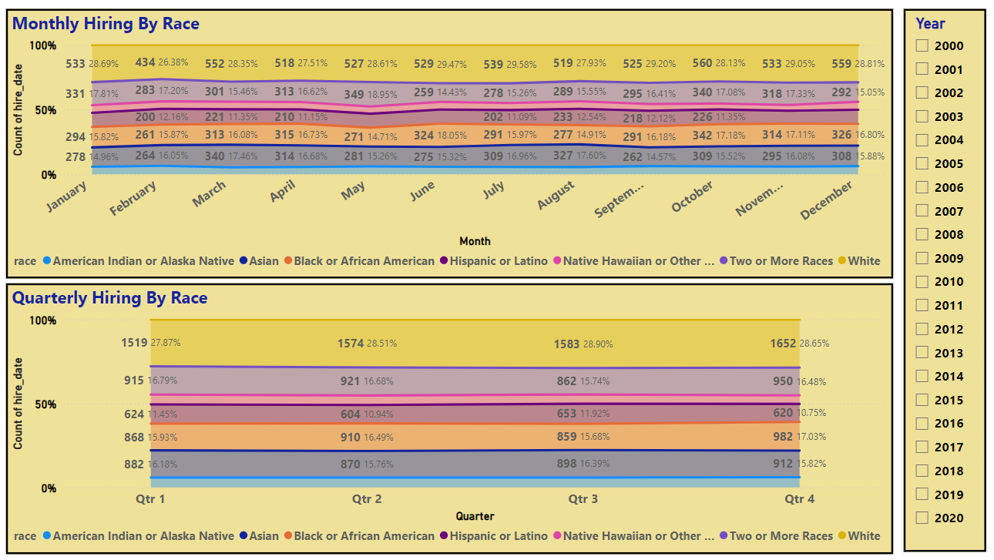
> Multiple Insights ..
Fig 19 :Monthly and Quarterly Hiring By Race.

Slide 36
> Multiple Insights ..
Monthly & Quarterly Termination Trends.
From the monthly termination insights, it shows that March has the most terminations and February has the least terminations.
Terminations peaked in March at 362, possibly indicating the end of fiscal-year contracts or performance review cycles.
The decline towards the end of the year, with both November and December having 315 terminations, could suggest higher retention during the holiday seasons.
Termination numbers appear relatively stable around the mid-300s, indicating a consistent turnover rate throughout most of the year.
A noticeable increase from Feb (288) to Mar (362) followed by astable period suggest potential mid-year evaluations or project completion influencing employee departure.

Slide 37
> Multiple Insights ..
Monthly & Quarterly Termination Trends.
From the quarterly termination insights, the second quarter shows the highest termination rate (1009), which might indicate a period of organizational changes or post performance review adjustments.
The first quarter has the lowest termination rate (951), suggesting better retention at the beginning of the year, possibly due to new year goals and initiatives.
There is a gradual decline in terminations from Q2 (1009) to Q4 (972), indicating improving retention strategies or stabilization post-major organizational changes.
The peak in Q2 can serve as a benchmark for evaluating the impact of HR initiatives implemented after this period to reduce turnover rates.

Slide 38
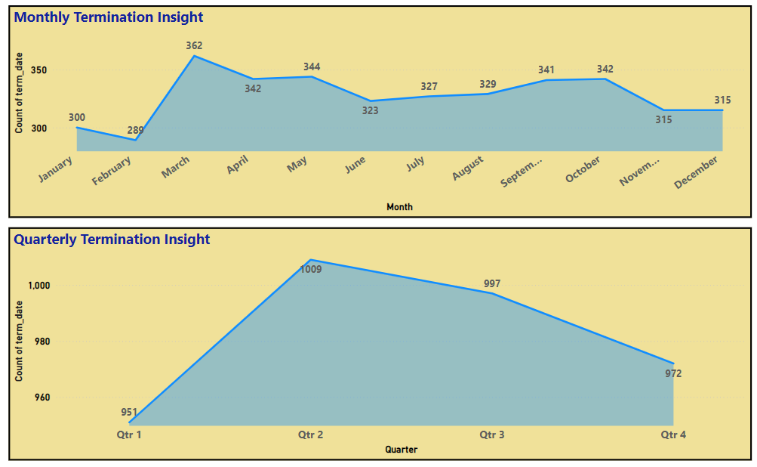
> Multiple Insights ..
Fig 20 :Monthly and Quarterly Termination Insights.

Slide 39
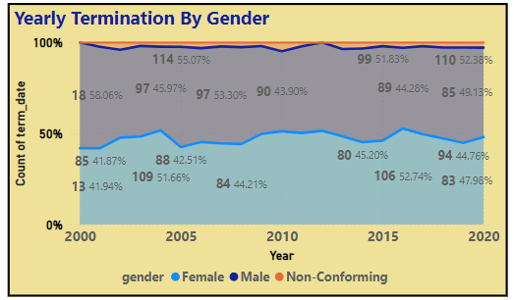
> Multiple Insights ..
I . Yearly Termination Trends By Gender
Male vs. Female Termination Rates, shows that males consistently have higher termination rates compared to females. This might indicate gender-specific challenges or differences in job satisfaction and career progression.
Non-Conforming Stability: Termination rates for Non-Conforming individuals remain very low and stable, suggesting either a small population size or effective retention strategies for this group.
Fig 21 : Yearly Termination By Gender.

Slide 40
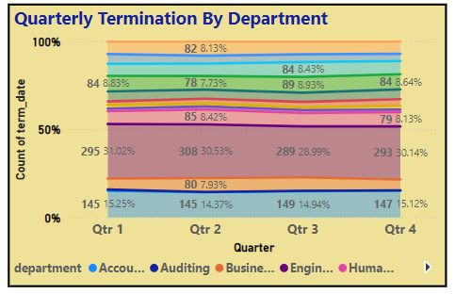
> Multiple Insights ..
II . Quarterly Termination Trends By Department
High-Turnover Departments like Accounting and Engineering have higher termination rates, which could be due to the high-pressure environment or competitive nature of the roles.
Low-Turnover Departments like Legal and Auditing have lower termination rates, possibly indicating higher job satisfaction or stability in these areas.
Departmental Trends: Analyzing trends over the years can help identify if certain initiatives or changes in management have impacted turnover rates in specific departments.
Fig 22 : Yearly Termination By Department.

Slide 41
> Multiple Insights ..
III . Quarterly Termination Trends By Race
White group consistently has the highest termination rate each quarter, peaking at 29.63% in Q4. This could indicate specific challenges faced by White employees or larger representation within the workforce.
Asian has termination rate is relatively stable, hovering around 16-17% each quarter. This stability might suggest effective retention strategies or satisfaction within roles.
Black or African American has termination rate fluctuates, peaking at 12.14% in Q3. This suggests possible external factors or specific challenges impacting this group.
Hispanic or Latino has termination rate is quite consistent, with a slight peak in Q1 at 17.46%. This could indicate seasonal or cyclical patterns affecting this group.
Two or More Races group shows varied termination rates, peaking in Q3 at 17.65%. This variability suggests a need for targeted retention efforts for employees identifying with multiple racial backgrounds.

Slide 42
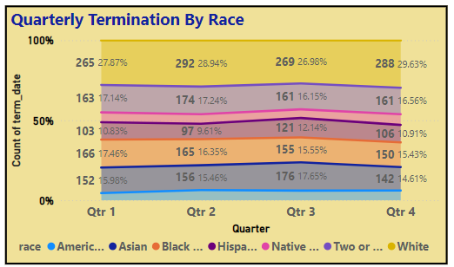
> Multiple Insights ..
Fig 23 : Quarterly Termination By Race.

Slide 43
> Multiple Insights ..
IV . Quarterly Termination Trends By Age Group
Age group 20-30 (Blue) shows a general increase in terminations over the years. The highest termination rate was 41.01% in 2018, indicating potential dissatisfaction or higher turnover among younger employees. Younger employees might be leaving for better opportunities, further education, or due to a lack of career development within the company.
Age group 31-40 (Orange) shows termination rates fluctuate, with significant peaks and troughs. The highest rate was 31.53% in 2000, while the lowest was 11.76% in 2013. This group might be affected by external economic conditions or internal company changes, leading to varied termination rates.
Age group 41-50 (Gray) is relatively stable termination rates with minor fluctuations. The highest rate was 29.87% in 2011. This group's stability suggests they might have reached mid-career stability, but fluctuations could be due to organizational restructuring or personal reasons.
Age group 51-60 (Purple) shows the gradual increase in terminations, peaking towards the end of the period. The highest rate was 30.06% in 2020. Increasing terminations in this group might be due to retirements or health-related issues.

Slide 44
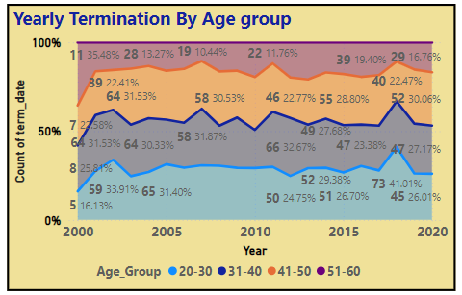
> Multiple Insights ..
Fig 23 : Yearly Termination By Age Group.

Slide 45
Thank You

